Slide 1
Dmitri Mendeleev and the Periodic Table

Slide 2
Dmitry Mendeleev.
Biography
https://www.science-story-telling.eu/fileadmin/content/projekte/storytelling/biografien/biografien-eng/mendeleev-biografie-gb.pdf#:~:text=Dmitri%20Ivanovich%20Mendeleev%20(1834%20%E2%80%93,He%20is%20best%20known%20for
************************************************************************************************************
Assignment
Read Dmitri Mendeleev’s biography
Complete the activity questions
Submit to Google Classroom
Biography Activities
Part 1 — The Scientist
1. When and where was Dmitri Mendeleev born?
2. What subject did Mendeleev study?
3. What problem were scientists trying to solve before the periodic table?

Slide 3
Part 2 — The Discovery(Understanding the contribution)
How did Mendeleev organize the elements?
What pattern did he notice?
What is the periodic law?
*****************************************************************************
Part 3 — The Bold (creative) Idea
Why did Mendeleev leave gaps in his table?
What did he predict about missing elements?
Name one element that was discovered later and proved him correct.
*******************************************************************************
Part 4 — Thinking Like a Scientist
1. Why was Mendeleev’s idea important for science?
2. Why do you think scientists trusted Mendeleev’s table?

Slide 4
Mendeleev’s Contribution to Science
In 1869, Dmitri Mendeleev created the first widely accepted periodic table.
He organized elements by:
increasing atomic mass
repeating properties
This pattern became known as the Periodic Law.
Mendeleev’s Most Important Idea
Mendeleev noticed that some elements were missing.
Instead of changing the pattern, he:
-left empty spaces in the table
-predicted the properties of unknown elements

Slide 5
Mendeleev’s Contribution to Science (cont.)
Later, scientists discovered elements such as:
-gallium
-germanium
Their properties matched Mendeleev’s predictions.
This proved his table was correct.
Why Mendeleev Matters
Mendeleev’s work:
-helped scientists organize elements
-corrected mistakes in atomic measurements
-became the foundation of the modern periodic table
Because of this, Mendeleev is called:
“The Father of the Periodic Table.”

Slide 6
Self-Learning Activity
Discover the Pattern
Instructions:
Look carefully at the information below.
Answer the questions step by step to discover the pattern.
Part 1 — Number Pattern
10 → 20 → 30 → ___ → 50 → 60
How much does the number increase each time?
What number is missing?
How did you figure it out?

Slide 7
Part 2 — Property Pattern
reacts with water
soft metal
reacts with water
________________________
reacts with water
What pattern do you notice?
What property is missing?
Explain your thinking.

Slide 8
Part 3 — Connect to Science
Read this sentence:
Scientists sometimes use patterns to predict missing information.
How did you use patterns to find the missing number?
How did you use patterns to find the missing property?
Why might patterns be helpful for scientists?

Slide 9
Before the Periodic Table:
How Scientists Worked with Elements
Before the periodic table, scientists studied elements one by one without a clear system. This made it hard to understand how elements were related.They tried to:
Discover new elements
Write down their properties (like color, weight, and how they react)
Group similar elements together
But there was no organized chart, so it was confusing.
Another way to explain it:
Before the periodic table was created, scientists worked with elements by studying them individually and making lists of their properties. They tried to group similar elements together, but there was no clear system. The periodic table helped organize the elements and made them easier to understand.

Slide 10
What Is the Periodic Table?
The periodic table is a chart that shows all the elements in the world.
Elements are the basic materials that everything is made of, like:
Oxygen (we breathe it)
Iron (used to make metal)
Gold (used in jewelry)
Carbon (found in living things)
Simple definition:The periodic table is a chart that organizes all the elements.

Slide 11
Why Mendeleev Created the Periodic Table
Before the periodic table, scientists discovered many elements but had no clear way to organize them. It was confusing. The periodic table helped scientists:
-Organize elements
-Find patterns
-Understand elements better
********************************************************************************
How the Periodic Table Is Organized
Across (Horizontal Rows) = PeriodsElements go across in number order.Each element has one more proton than the one before it.
Example:Hydrogen → Helium → Lithium
Across = counting order

Slide 12
Down (Vertical Columns) = Groups or Families
Elements go down because they behave in similar ways.
Example:
Helium
Neon
Argon
They are all:
Gases
Stable
Do not react much
Down = similar behavior

Slide 13
What Each Square Shows
Each box shows one element. Usually it shows:
Element name (Oxygen)
Symbol (O)
Atomic number (8)
Example:O = Oxygen

Slide 14
Patterns in the Periodic Table
The periodic table shows patterns, meaning things repeat in a predictable way.
Examples:
Similar elements are in the same column
Metals are mostly on the left
Gases are on the right
Easy Analogy
The periodic table is like a classroom seating chart.
Each element has:
-Its own place
-Its own name
-Similar elements sit together

Slide 15
Mendeleev’s Predicted Elements
Predicted Name Real Element Year Discovered Did it Match?
Eka-aluminum Gallium 1875 Yes – very close
Eka-boron Scandium 1879 Yes – very close
Eka-silicon Germanium 1886 Yes – very close
*******************************************************************************
How Dmitri Mendeleev Predicted New Elements
Mendeleev predicted new elements by studying patterns in the periodic table. He noticed that elements with similar properties appeared at regular intervals, so he knew some elements were missing.
Step 1 – He Organized the Elements
Mendeleev arranged the elements by their atomic mass (from lightest to heaviest).
When he did this, he noticed that similar elements lined up in columns.
Example:
Some metals behaved similarly
Some gases behaved similarly

Slide 16
Step 2 – He Saw Empty Spaces
Sometimes the pattern did not fit perfectly.
Instead of forcing elements into the wrong place, Mendeleev left empty spaces.
He believed:"These spaces are for elements that have not been discovered yet.“
**********************************************************************************
Step 3 – He Predicted Their Properties
Mendeleev studied the elements around the empty spaces and made predictions.He predicted:
-Weight-
-Density
-Melting point
-Chemical behavior
Example:He predicted an element he called eka-silicon, which later became germanium.

Slide 17
Step 4 – Scientists Later Found Them
Years later, scientists discovered the missing elements, and they matched Mendeleev’s predictions very closely.
This proved that the periodic table worked.
Simple Explanation
Mendeleev predicted new elements by studying patterns in the periodic table and leaving spaces for elements that had not been discovered yet.
********************************************************************************
Mendeleev predicted elements by arranging known elements in a pattern. When he saw gaps in the pattern, he left empty spaces and predicted the properties of the missing elements.

Slide 18
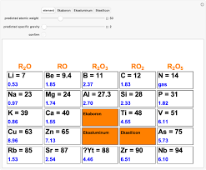

Slide 19
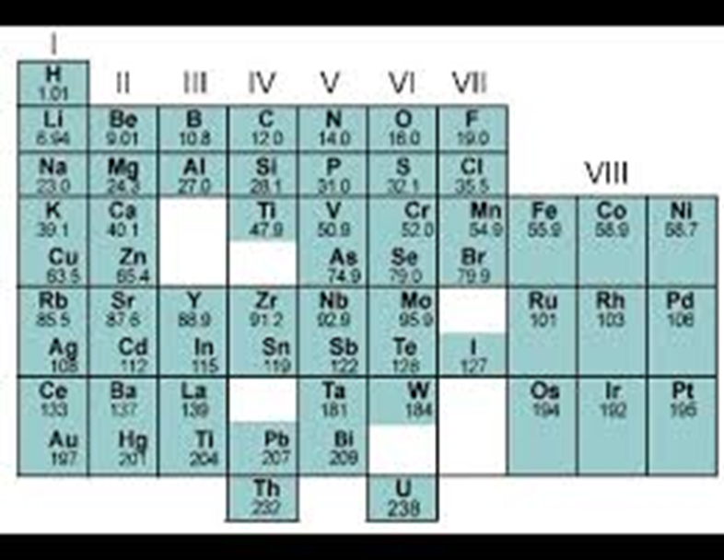

Slide 20
What the Numbers Mean in Each Box
Each element box contains several kinds of numbers:
1️⃣ Top Number (Small Decimal Number)
Example:Li = 7Be = 9.4B = 11This number is the atomic weight (atomic mass).
Meaning:How heavy the atom is compared to other atoms
Mendeleev arranged elements mostly by this number.
Summary: This number shows how heavy the element is.

Slide 21
Big Middle Number (Sometimes Red or Blue)
Example: Na = 23Mg = 24Si = 28
This is also the atomic weight (a more accurate value).
Sometimes Mendeleev predicted these numbers before the elements were discovered.
Example:Ekaboron = 45
Ekaluminum = 68
Ekasilicon = 72
These were predicted numbers.

Slide 22
Bottom Number (Small Number)
Example:Na = 0.97Mg = 1.74Cl = 3.5
This number shows the density of the element.
Density = how heavy something is for its size.Example:Iron is dense (heavy)
Wood is less dense (lighter)
Simple explanation:This number shows how heavy the element is for its size.

Slide 23
Special Boxes (Missing Elements)
Boxes labeled:
Ekaboron
Ekaluminum
Ekasilicon
These were elements Mendeleev predicted but scientists had not found yet.
The numbers there are his predictions.
Later scientists discovered:
Ekaboron → Scandium
Ekaluminum → Gallium
Ekasilicon → Germanium

Slide 24
Top Row (R₂O, RO, R₂O₃, RO₂, R₂O₅)
These show how elements combine with oxygen.
Example:
R₂O → elements like sodium
RO → elements like magnesium
This helped Mendeleev group similar elements together.
Simple Summary
Each box shows:
Element symbol (Na = Sodium)
Atomic weight (how heavy it is)
Density (how heavy for its size)
Mendeleev used numbers like atomic weight and density to organize elements and predict missing ones.

Slide 25
HOMEWORK
Thinking Like a Scientist
Part 1: Answer the questions:
Why do scientists look for patterns?
Why was it important that Mendeleev did not change the pattern when elements were missing?
Part 2 — Pattern Practice
Complete the pattern.
Atomic mass pattern:5 → 10 → 15 → ___ → 25
Property pattern:metal → nonmetal → metal → ______
Missing number: __________Missing property: __________
Explain how you found the answers.

Slide 26
Work on the print out to get ready for the quiz

Slide 27
QUIZ TIME

